Slide 1
Unified Medical Language System (UMLS) Visualization
Welcome to the UMLS Visualization system.
This introduction section provides detailed information on how to use this website and understand various visualization.
You can navigate through this section by using the navigation arrows (sides) or bullets (bottom).

Slide 2
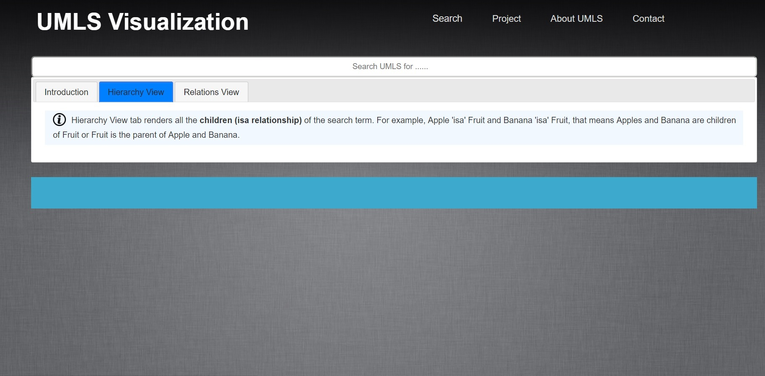
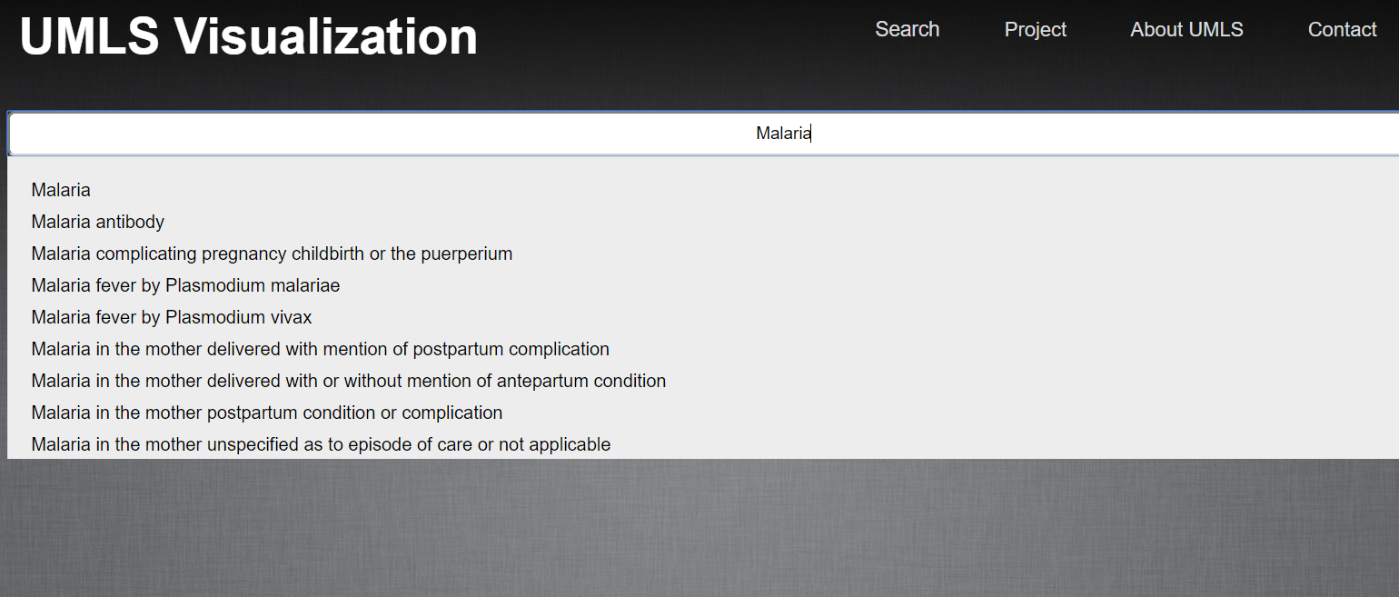
Start by typing in the search box. As you type (more than 3 characters), the results will appear and you can make a selection as shown below.

Slide 3
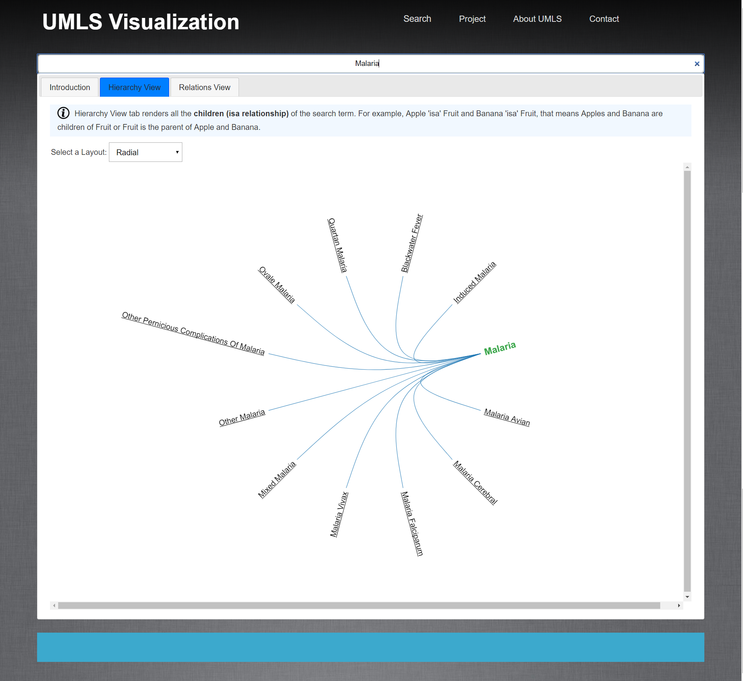
1
They are two tabs: Hierarchy and Relations View. These two tabs provides you all the information about the searched concept.
2
The Hierarchy View – displays all the direct children of the concept. For instance, this figure shows all the children (Other Malaria, Ovale Malaria, etc.) of the term Malaria.
Hierarchy is something we encounter daily. For example
Fruit is a general term, Apple is a Fruit and further Gala Apple, Pink Lady, and Honey Crisp are also Apples. You can continue such hierarchy for Banana, Grapes, Organes, etc.
Another example is our families. We are the children of our Parents, who are children of our grandparents and so on.

Slide 4
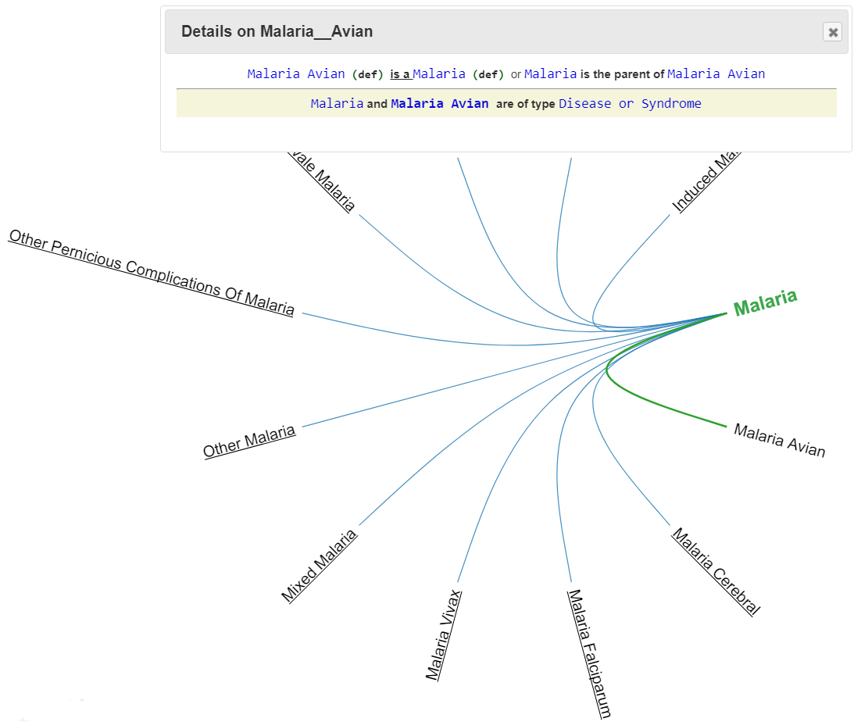

3
2
You can also click on the “def” link besides the terms to obtain the definition(s) provided by various standard healthcare organizations.
The definition(s) will appear in a different dialog box.
The “Details” box will appear once you hover over the term (displayed in the title). This box provides simple explanation of what knowledge the graph is displaying. In this example, it states that Malaria Avian is a child (or isa) of Malaria or Malaria is the parent of Malaria Avian.
Also, the arc between the terms will turn “green” in color.
If they are multiple connections between terms, all the arc’s will turn green and respective knowledge will be displayed in the box.
4
You can close the “Details” box (and Definition box) by clicking the “x” on the top-right corner or using “ESC” button.
1
You can hover over the terms to obtain more details such as how is this term connected to the search term (always in bold green) or other terms? and What is definition of the term?

Slide 5
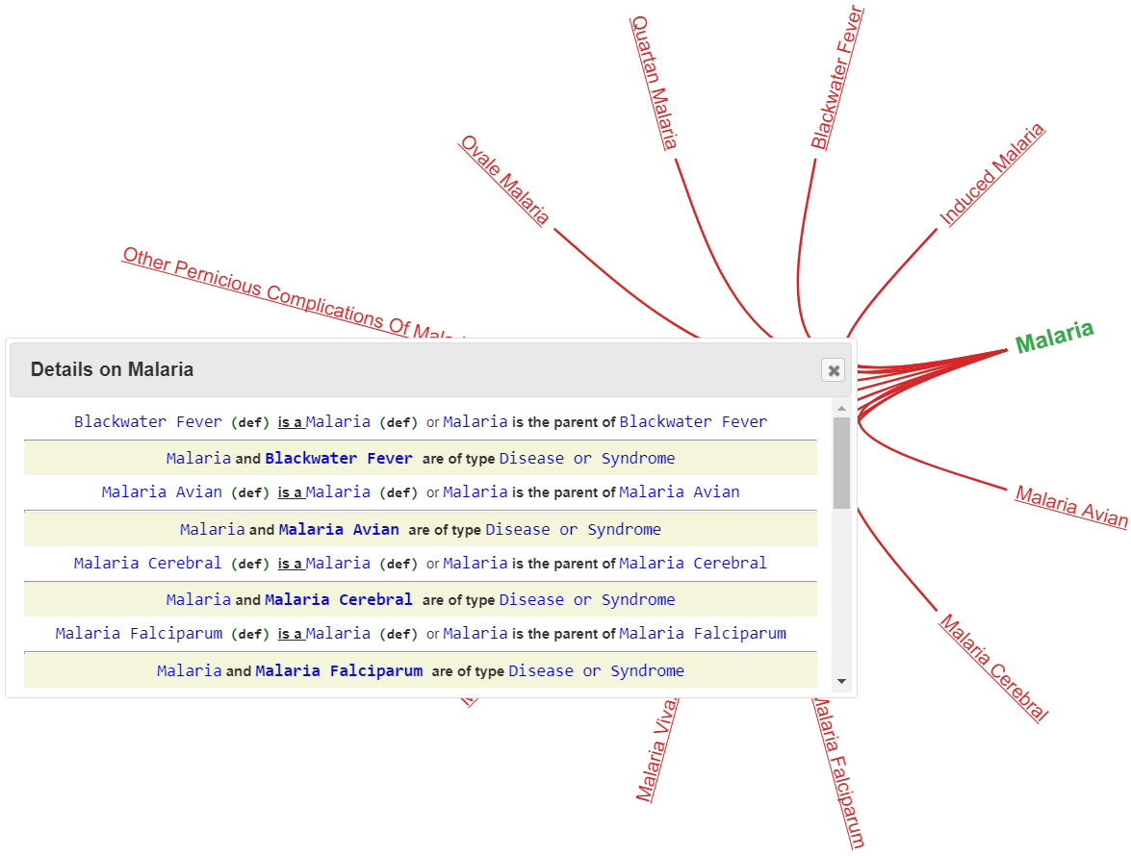
1
You can hover over the search term, in this case Malaria, to see its connection to other terms.
As Malaria is the parent of the terms, the arc’s are “red” in color indicating the term you currently viewing is the parent.
The same is explained in the “Details” box.

Slide 6
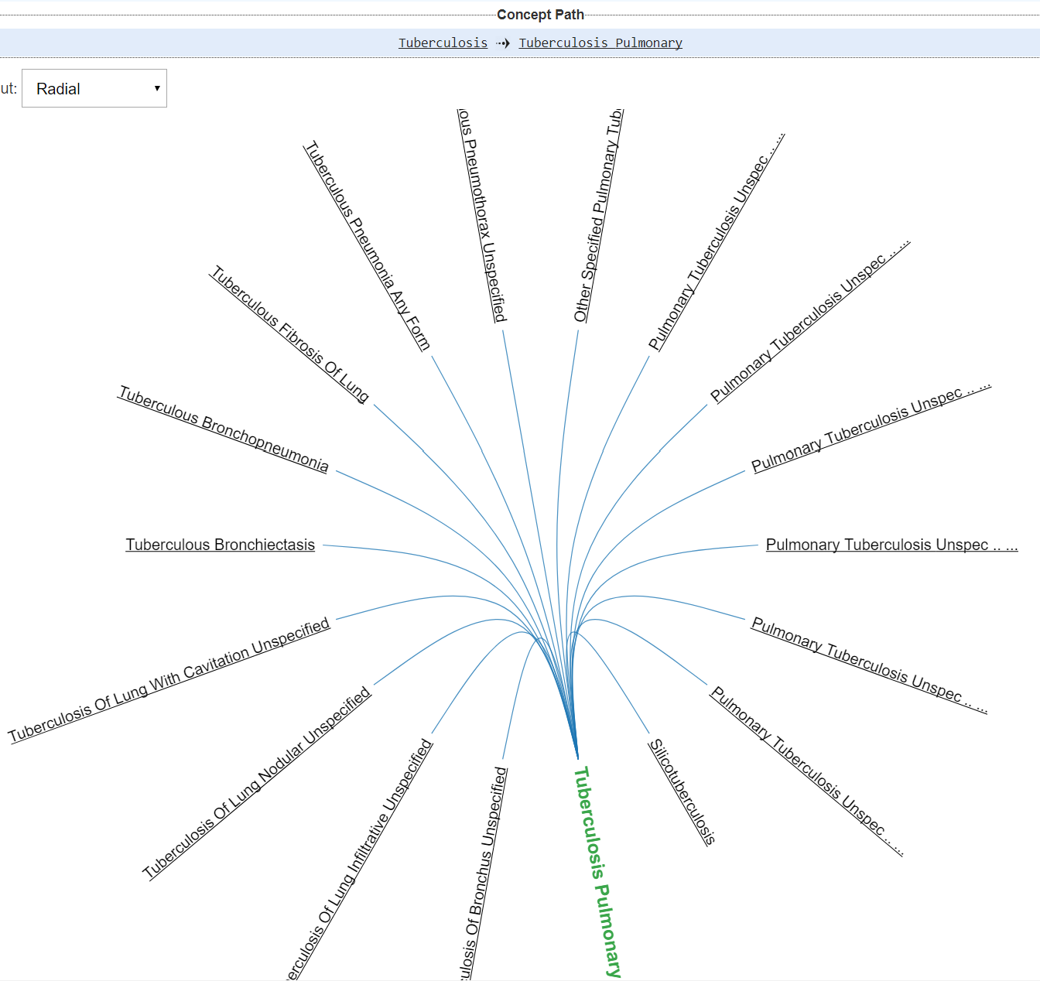
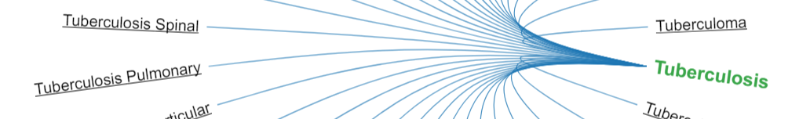
1
In this example, the search term is Tuberculosis and Tuberculosis Pulmonary is one of its children.
You can click on the any child term to obtain its own children. The graph on the right shows the children of Tuberculosis Pulmonary. This makes Tuberculosis Pulmonary the current search term and thus is in bold green.
This also means that an child of Tuberculosis Pulmonary is also a child of Tuberculosis.
2
You can keep on browsing to obtain the children of any term. The “Concept Path” shows the traversal path. It shows you where you have started and you current term. In this example, you started with Tuberculosis, and then clicked on Tuberculosis Pulmonary.
If you click on Tuberculosis Bronchiectasis, the path will be Tuberculosis, → Tuberculosis Pulmonary → Tuberculosis Bronchiectasis,
This is very similar to your web browsing. You start at a point, then keep on browsing and your browser will remember your path.
If there any no more children for any term, the system will display a message and empty graph will be shown.
You can go back to any term by clicking on it in the Concept Path. If you click on Tuberculosis you will go back to the start.

Slide 7
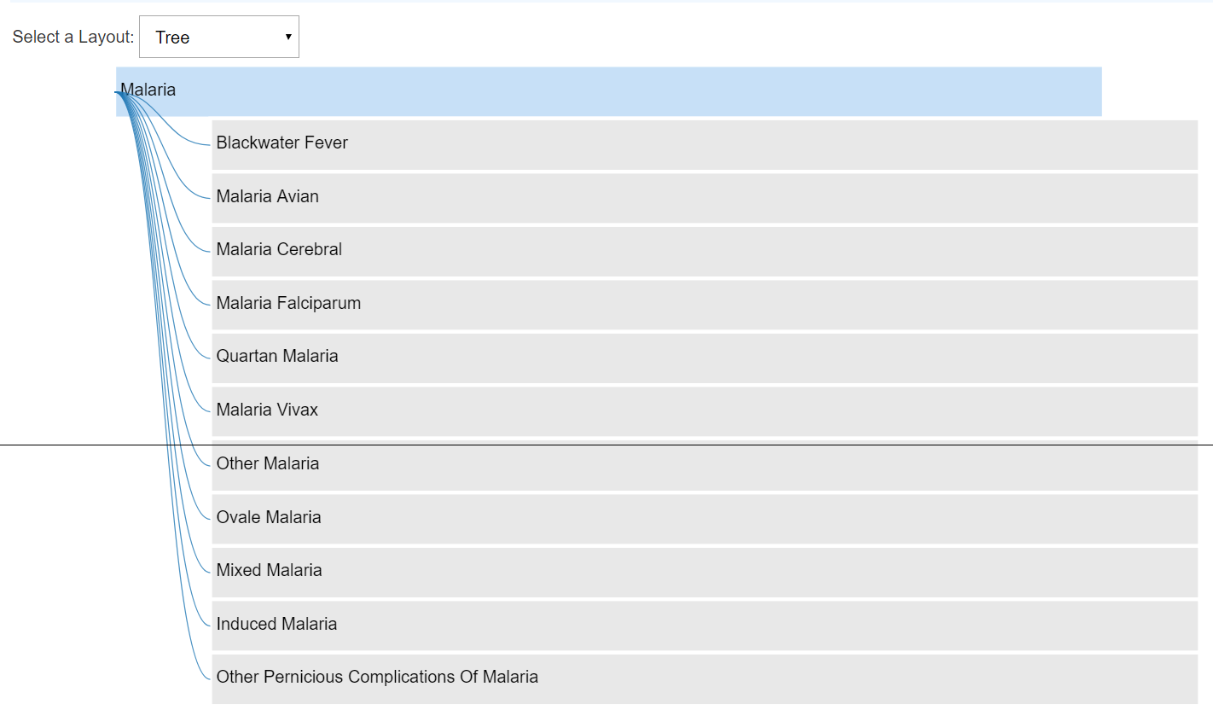
1
2
In the previous examples (shown below), the layout is called as “Radial” layout and is the default layout of the system.
You can change the layout to a “Tree” layout (shown below) by changing the selection to “Tree” in the selection box.

Slide 8
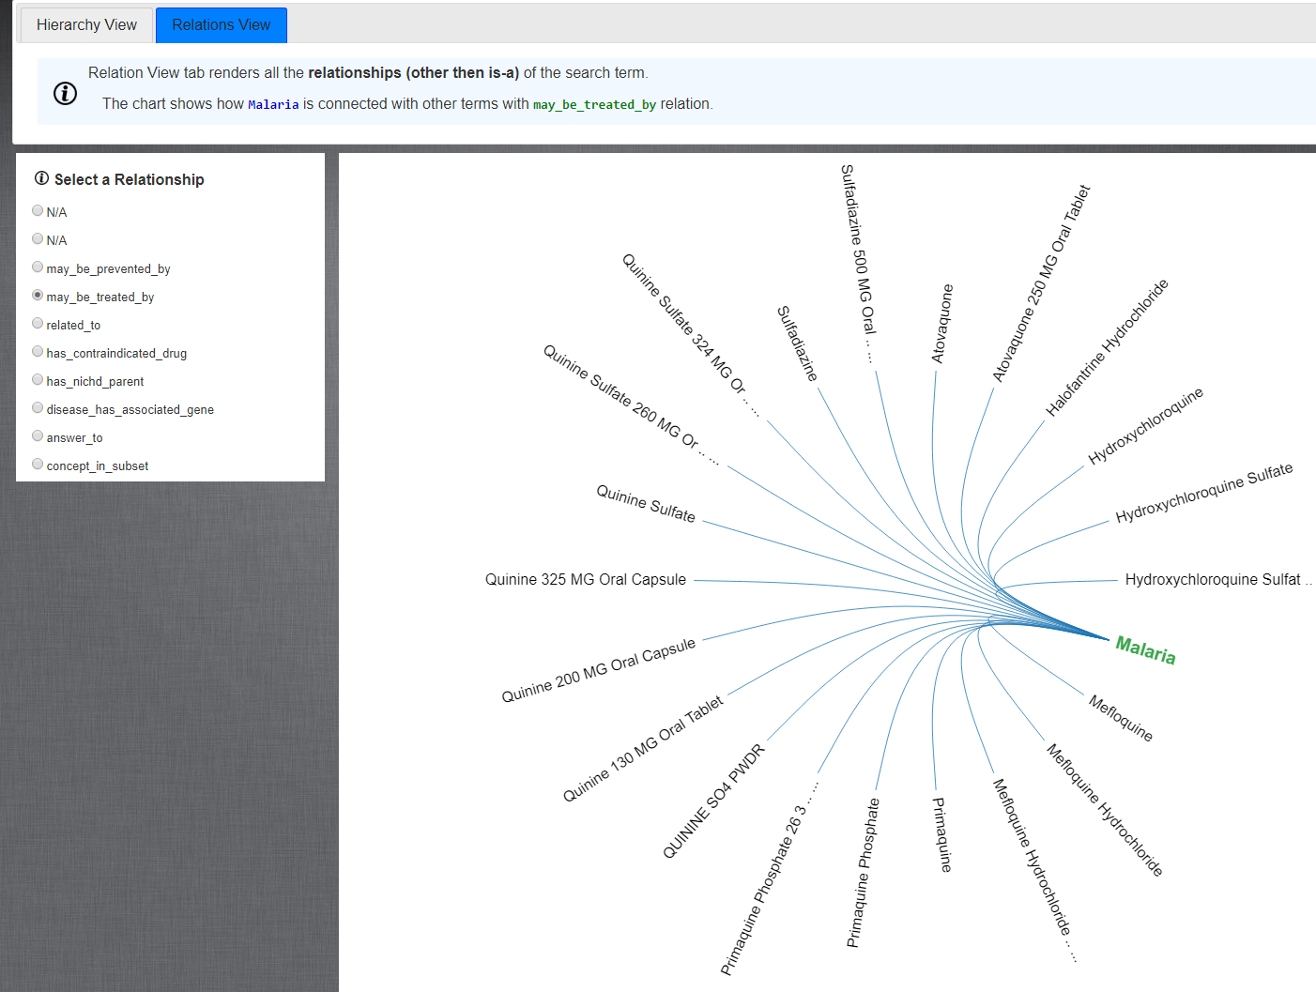
1
The second tab, “Relations View” tab shows all the relationships (apart from hierarchy) the search term has with the medical and non-medical terms.
This similar to our regular relationships we encounter in your life. For example, “Dr. Saripalle” – “teaches at” – “Illinois State University” or “Fever” – “maybe treated by” – “Advil”. Here, Fever and Advil are the term and “maybe treated by” is the relationship.
2
Showing all the relationships in one graph simply is not possible. Thus, we only display the knowledge based on the “selected” relationship. This figure is showing all the terms Malaria is connected to using “may_be_treated_by” relationship. The way to read this knowledge is: Malaria – maybe treated by - Doxycycline Monohydrate.
The graph will change based on your relationship selection.
You can also hover over the terms to obtain the “Details” box with explanation and obtain the definition (similar to Hierarchy View).

Slide 9
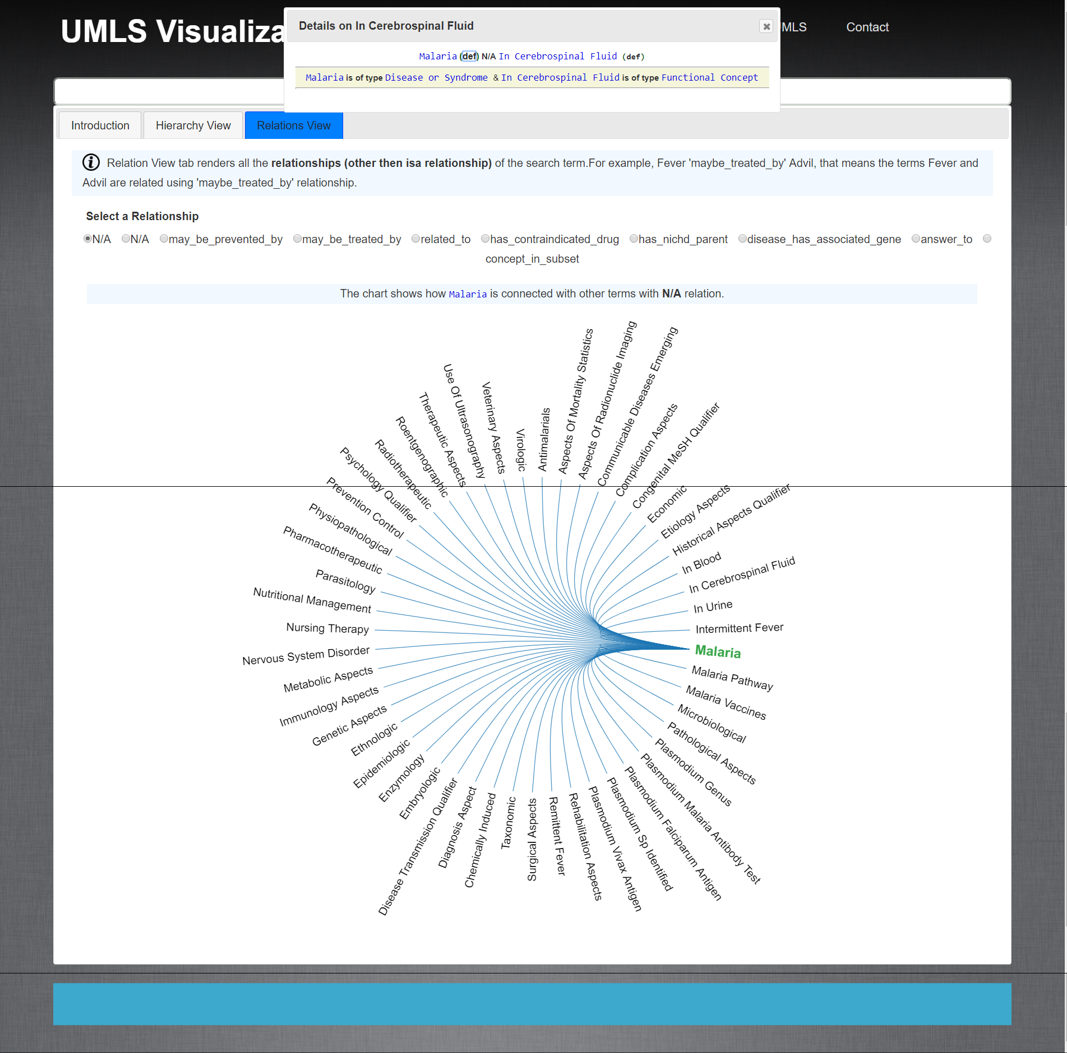
1
The “N/A” option in the relationships selection basically means that, the search term is connected to a term, but the experts are not sure or could not concluded on a specific relationship.
As shown in the figure, Malaria is connected with the term In Cerebrospinal Fluid, but the relationship is unknow, indicated by “N/A”
2
As previously stated, you will see the “Details” box when you hover over the terms. You can obtain the definition by clicking on “def” link besides the term.
On hover, the arc between the terms turn “violet”

Slide 10
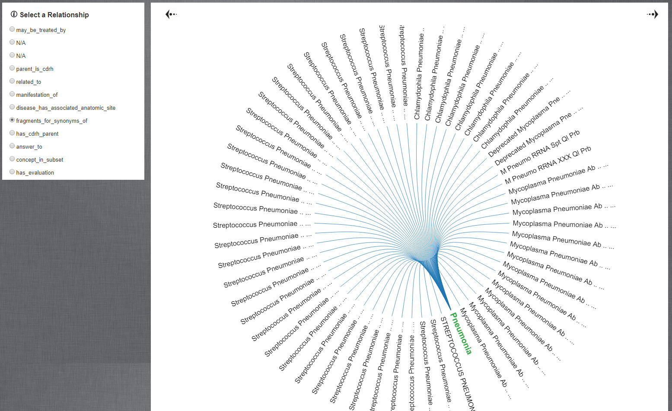
1
In a few occasions, a medical concept can be related to many other concepts using a given relationship.
For example, Pneumonia is connected to 537 concepts using “fragments_for_synonyms_of” relationship. Showing them all at once is useless.
In this these cases, the graph only shows a subset of the relationships and you can navigate to other concepts using left and right arrows.

